Slide 1
Modeling
(ML Basic Concepts)
ML_9900_1
S. Abbas Hosseini
Parishad BehnamGhader

Slide 2
Train / Test / Validation sets
Probabilistic modeling & different types of random variables (observed, latent)
Maximum Likelihood estimation
MAP estimation
Overfitting
Regularization
Linear basis functions
Outline

Slide 3
Splitting the Dataset
Some data to train :D
Evaluate model on data?! ⇒ test set
Loss value
Some other metrics such as Precision, F1, ...
Tuning hyperparameters?! ⇒ validation set
Neural network layers
Number of features and dimensions, ...
Do Not Use test set until the last step!

Slide 4
Probabilistic modeling & different types of RVs
Observed
usually has a measurement error associated with it
Latent (Hidden)
are not directly observed but are rather inferred
Nuisance

Slide 5
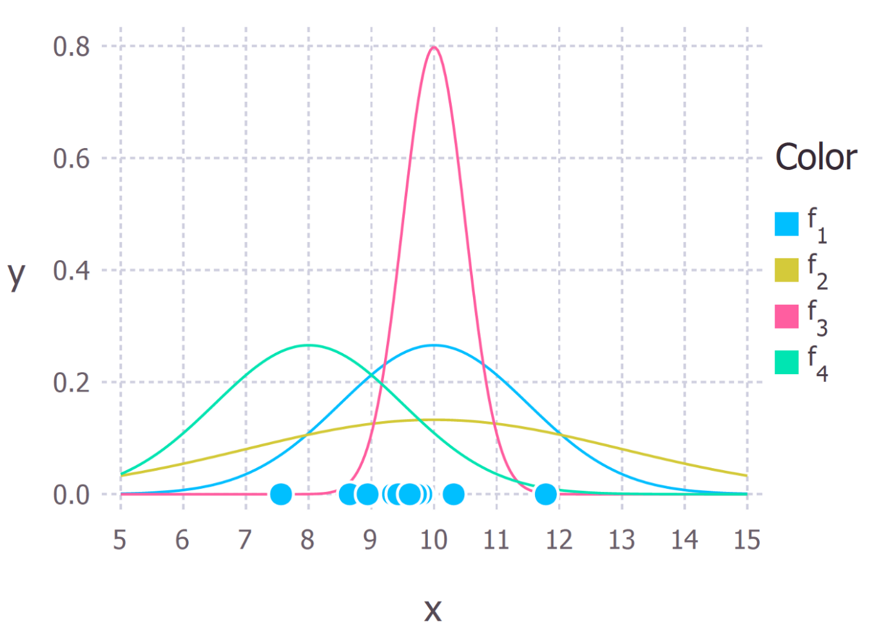
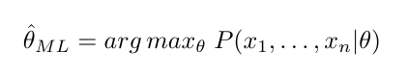
Maximum Likelihood Estimation
Estimating the parameters of a probability distribution by maximizing a likelihood function
With which parameters the observed data is more probable?
From towardsdatascience.com

Slide 6
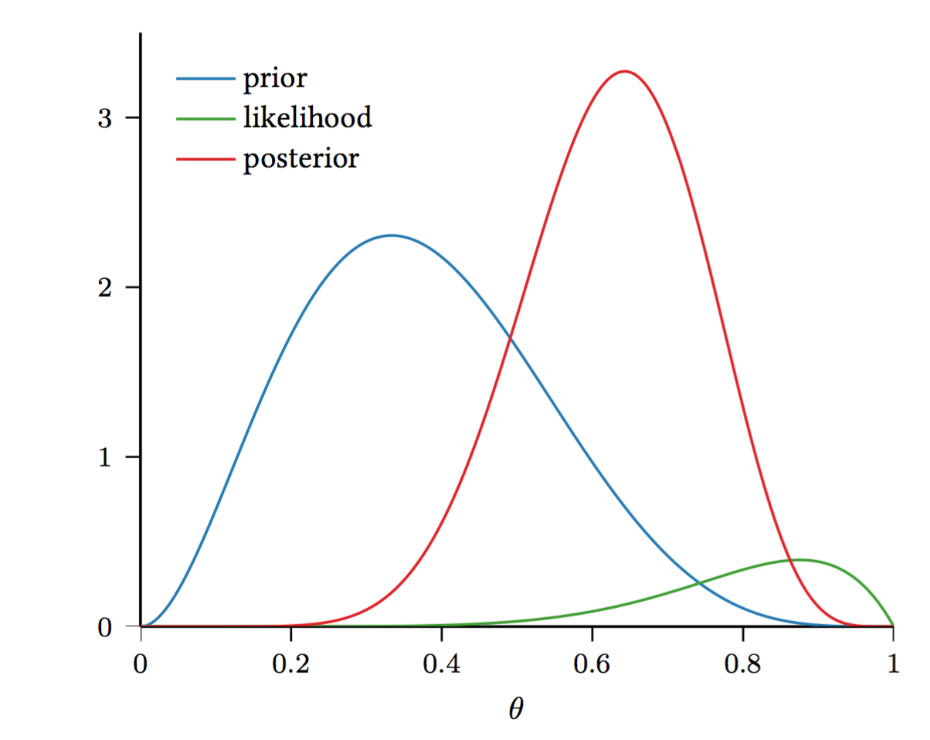
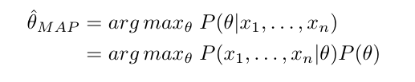
MAP Estimation
The mode of the posterior distribution
Calculated using prior distribution

Slide 7
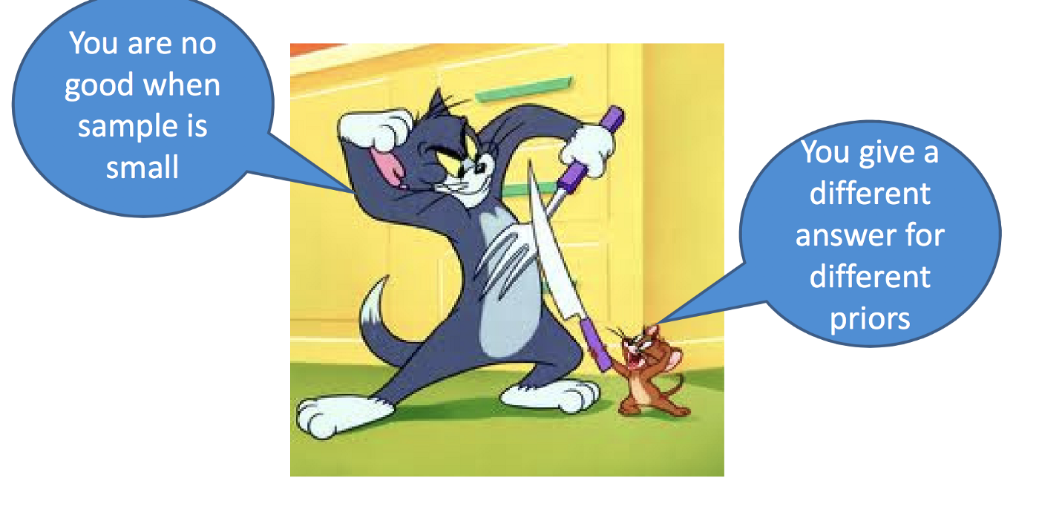
MAP
MLE
From cs.cmu.edu

Slide 8
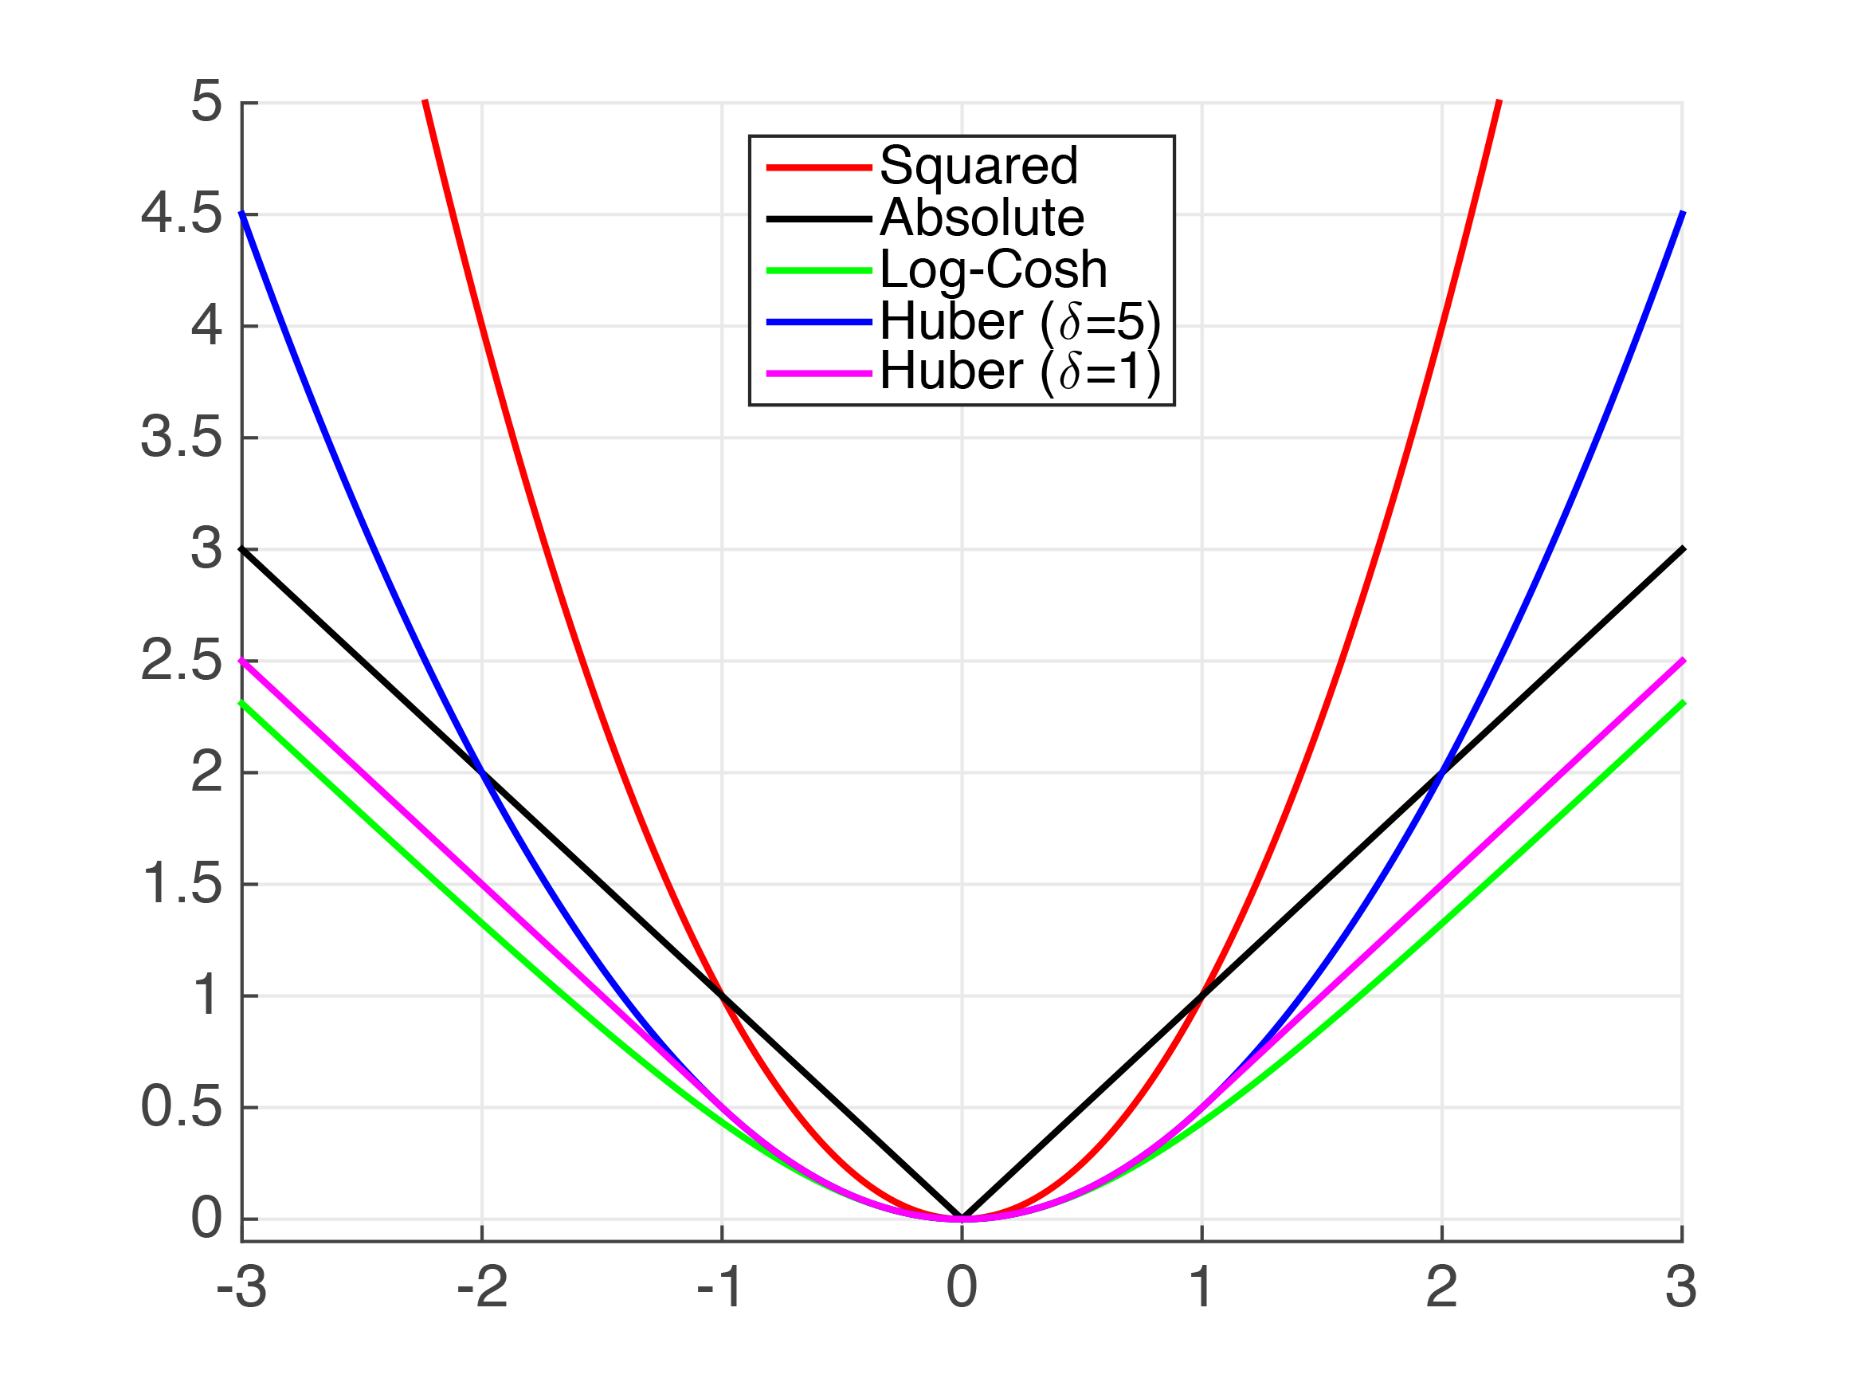
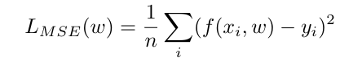
Regression Loss Functions
Mean Squared Error
Mean Absolute Error
Log-Cosh
Huber Loss (Smooth MAE)
From cs.cornell.edu

Slide 9
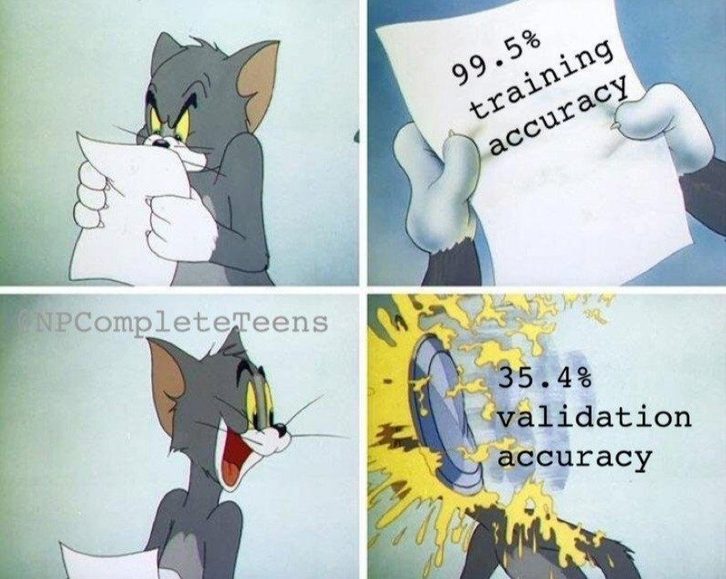
Overfitting
From twitter.com

Slide 10
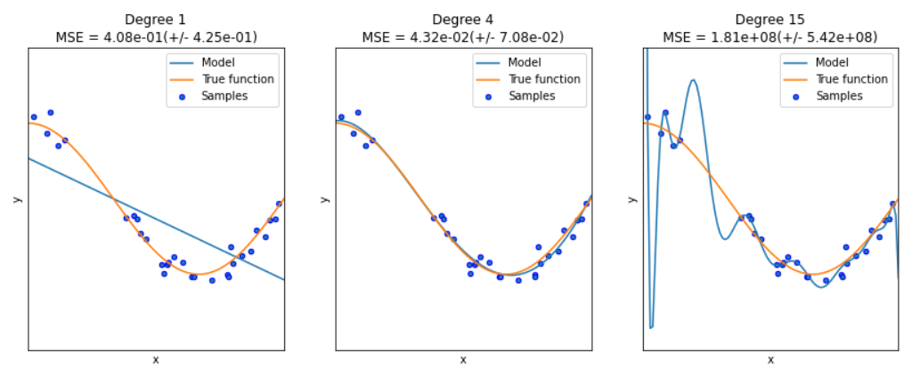
Overfitting (Cont.)
Occurs when model is too closely fit to a limited set of data points

Slide 11
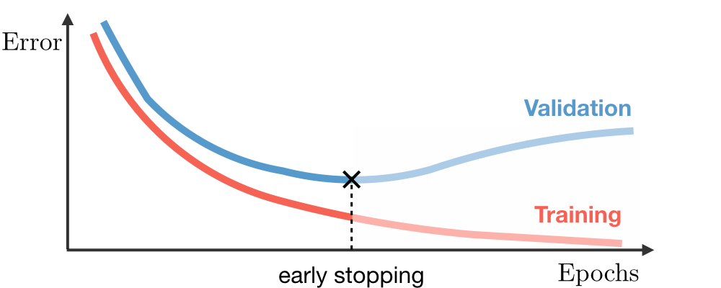
Overfitting (Cont.)
Model tries too hard to capture the noise in the training dataset
Overfitting can also happen on validation set!
Tuning too many values as hyperparameters on a limited validation set
From ori.codes

Slide 12
How to overcome Overfitting?
Early stopping
Data augmentation
Decrease the complexity of the model
...
Regularization (intuitively controls the flexibility of parameters)

Slide 13
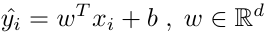
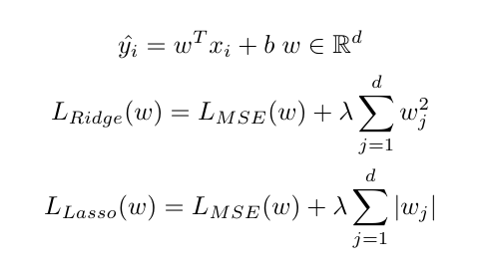
Regularization
Ridge Regression
Lasso Regression

Slide 14
Ridge Regression from different perspectives
Adding noise (e_{i} ~ N(0, a²)) to each dimension of data
X’_{i} = X_{i} + e_{i}
To be done in HW3 :-p
Knowing a prior about w (w ~ N(0,I))
How?

Slide 15
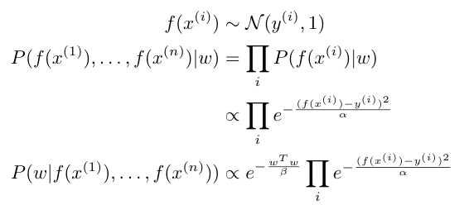
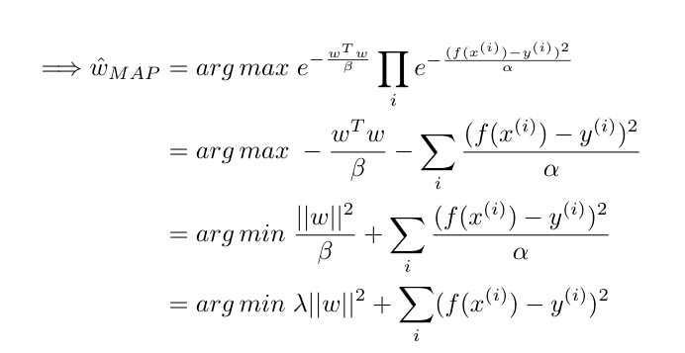
Question 1
Ridge Regression by having a prior knowledge about w (w ~ N(0,I))

Slide 16
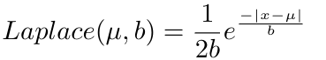
Question 1 (Cont.)
Ridge Regression by having a prior knowledge about w (w ~ N(0,I))
We can also estimate the uncertainty of f(x) with MLE (variance)
What if we wanted to reach Lasso Regression?!
To be done in HW4 :-p

Slide 17
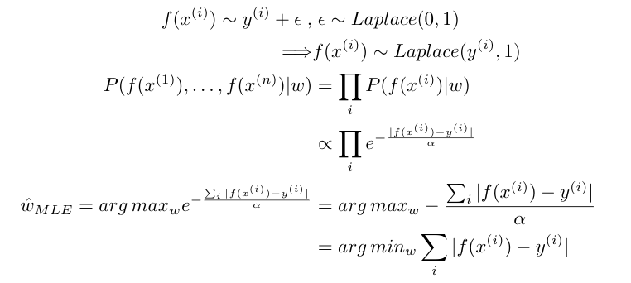
Question 2
Modeling f(x) with y + noise ~ Gaussian → Sum Squared Error
What if we model f(x) with a Laplacian noise?

Slide 18
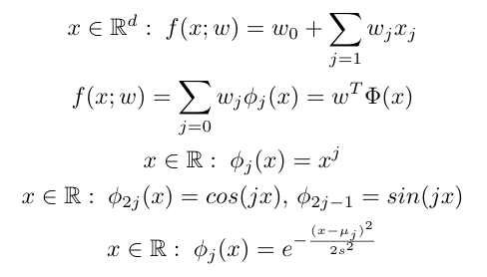
Linear basis functions
Linear Regression
Simple but limited!
Linear combinations of a set of basis functions
Polynomial basis functions
Global
a small change in x affects all basis functions
a small change in a basis function affects y for all x.
Gaussian basis functions
Local
a small change in x affects only nearby basis functions.
a change in a basis function affects y only for nearby x
Any other basis functions :D

Slide 19
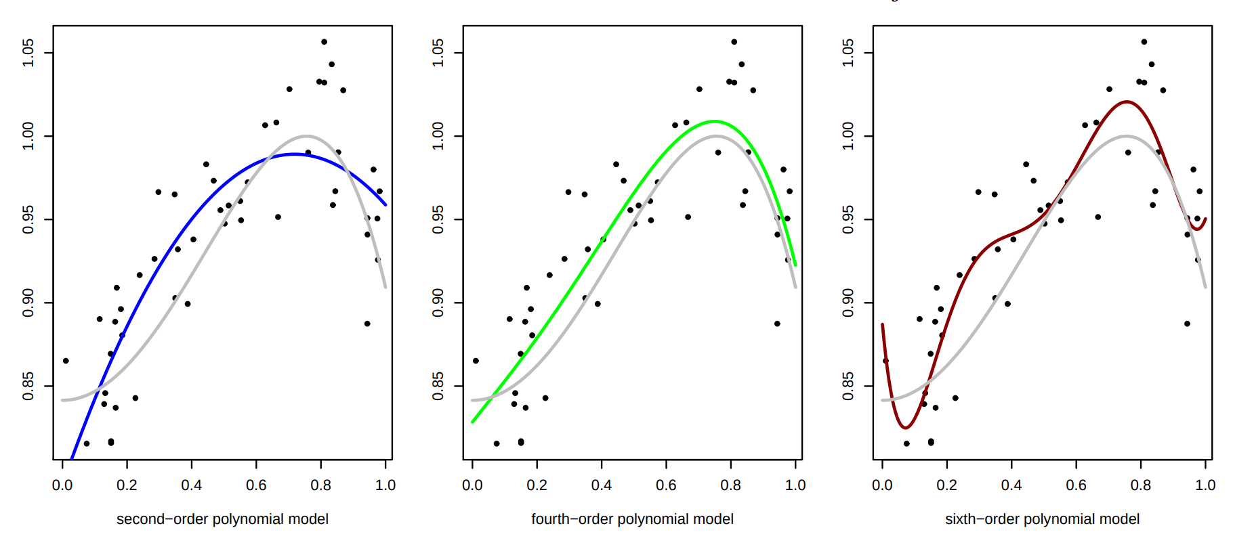
Polynomial basis functions
From utstat.utoronto.ca

Slide 20
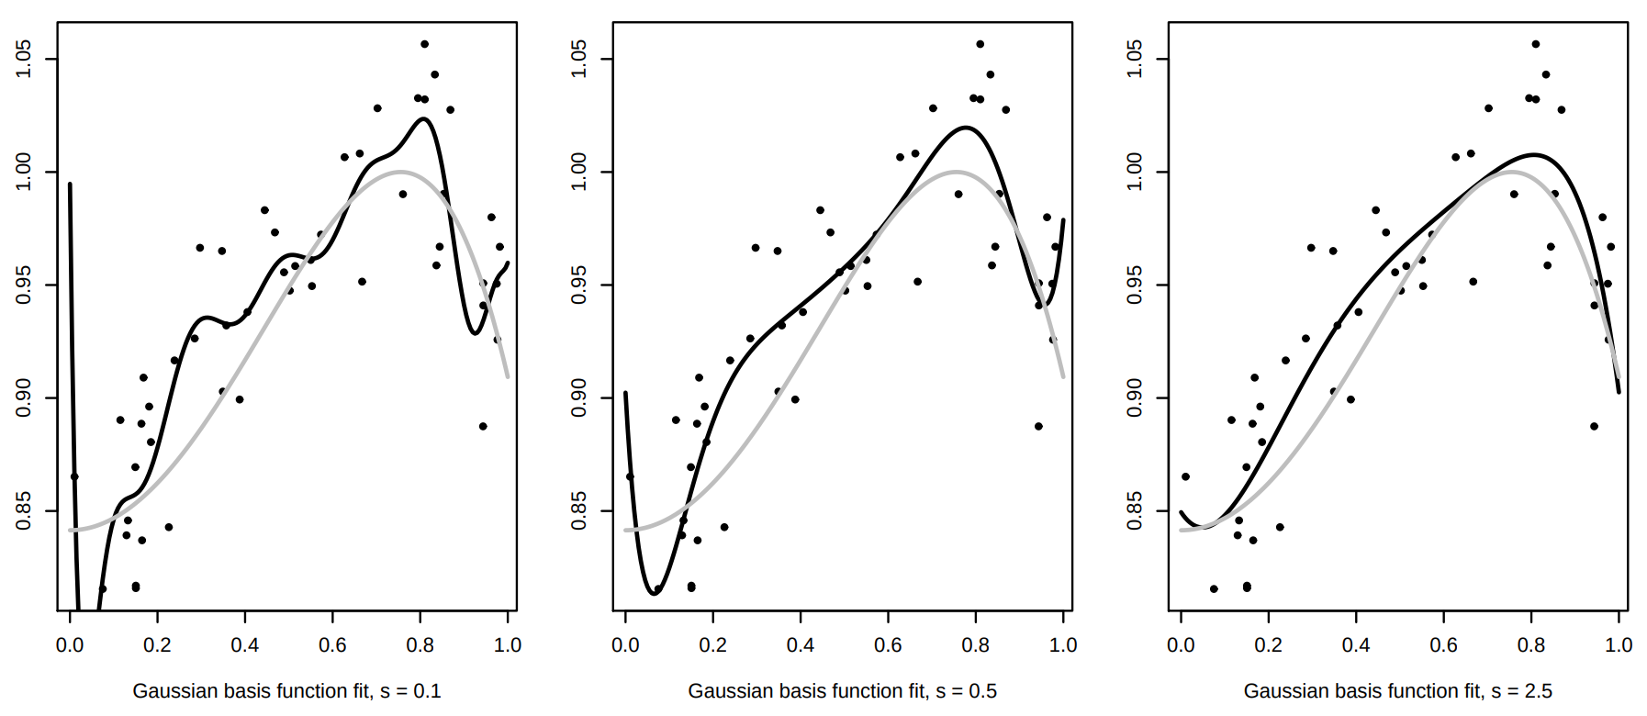
Gaussian basis functions
From utstat.utoronto.ca

Slide 21
Any Questions?

